Slide 1
CS-205 Data Structure and Algorithms
6. Recursion
Weihao Qu
Monmouth University

Slide 2
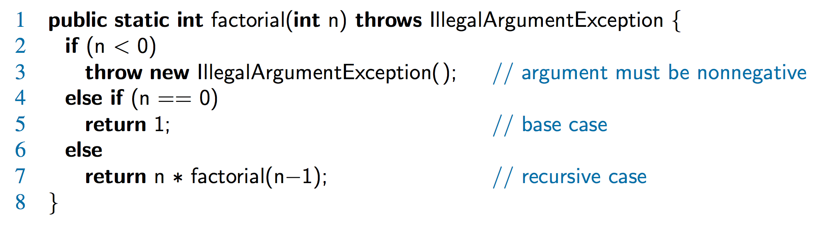
The Recursion Pattern
Recursion: when a method calls itself
Classic example – the factorial function:
n! = 1· 2· 3· ··· · (n-1)· n
Recursive definition:
As a Java method:

Slide 3
Content of a Recursive Method
Base case(s)
  Values of the input variables for which we perform no recursive calls are called base cases (there should be at least one base case).
  Every possible chain of recursive calls must eventually reach a base case.
Recursive calls
  Calls to the current method.
  Each recursive call should be defined so that it makes progress towards a base case.

Slide 4
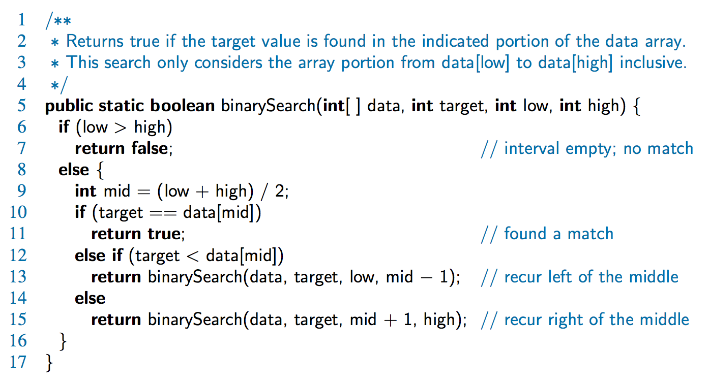
Binary Search
Search for an integer in an ordered list

Slide 5
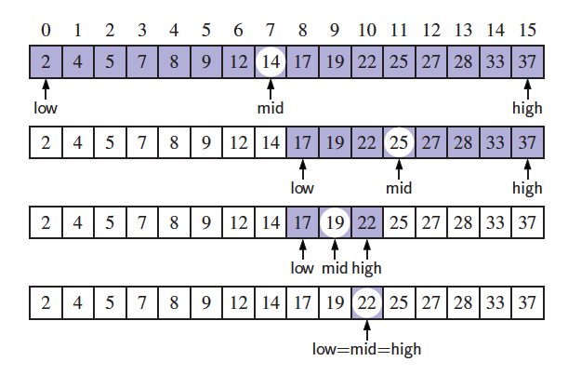
Visualizing Binary Search
We consider three cases:
  If the target equals data[mid], then we have found the target.
  If target < data[mid], then we recur on the first half of the sequence.
  If target > data[mid], then we recur on the second half of the sequence.

Slide 6
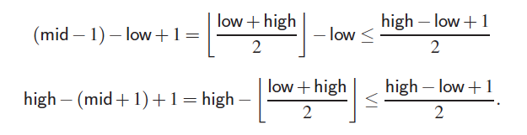
Analyzing Binary Search
Runs in O(log n) time.
  The remaining portion of the list is of size high – low + 1
  After one comparison, this becomes one of the following:
  Thus, each recursive call divides the search region in half; hence, there can be at most log n levels

Slide 7
Recursion
Two ways to process repetition: loops and recursion
Recursion is a method to call itself
The Factorial
n! = 1 if n = 0
= n*(n-1)*(n-2)….3*2*1 if n ≥ 0
Let factorial(n) = n!
Then factorial(n) = 1 if n = 0
= n*factorial(n-1) if n ≥ 0
public static int recursiveFactorial(int n) { // recursive factorial function
if (n == 0) return 1; // basis case
else return n * recursiveFactorial(n-1); // recursive case
}

Slide 8
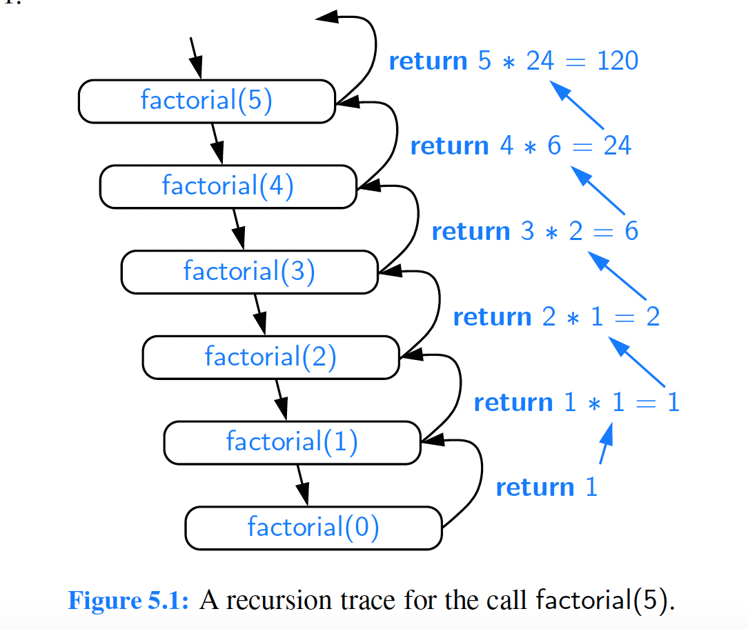
recursiveFactorial(int 5)

Slide 9
Linear Recursion
Test for base cases
  Begin by testing for a set of base cases (there should be at least one).
  Every possible chain of recursive calls must eventually reach a base case, and the handling of each base case should not use recursion.
Recur once
  Perform a single recursive call
  This step may have a test that decides which of several possible recursive calls to make, but it should ultimately make just one of these calls
  Define each possible recursive call so that it makes progress towards a base case.

Slide 10
Linear recursion
A method is defined so that it makes at most one recursive call each time it is invoked
Example: sum the first n integer array elements of array A
Algorithm LinearSum(A, n)
Input: An integer array A, some integer n ≥ 1
Output: Sum of the first n elements of the array A
if n = 1 then
return A[0];
else
return LinearSum(A, n-1) +A[n-1]

Slide 11
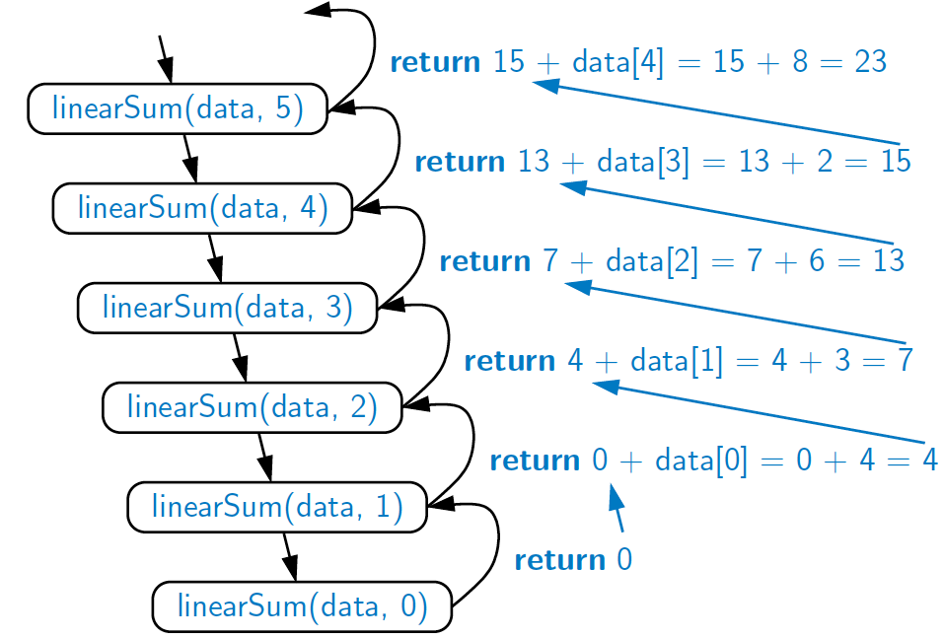
Example of Linear Recursion
Recursion trace of linearSum(data, 5) called on array data = [4, 3, 6, 2, 8]
Algorithm linearSum(A, n):
Input:
Array, A, of integers
Integer n such that
0 ≤ n ≤ |A|
Output:
Sum of the first n
integers in A
if n = 0 then
return 0
else
return
linearSum(A, n - 1) + A[n - 1]

Slide 12
Linear recursion
Example: Reversing an array by recursion
Algorithm ReverseArray(A, i, j)
Input: An integer array A, non-negative indices i and j
Output: The reversal of elements in A starting at index i and ending at j
if i<j then
Swap A[i] and A[j]
ReverseArray(A, i+1, j-1) ← tail recursion
return

Slide 13
Reversing an Array
Algorithm reverseArray(A, i, j):
Input: An array A and nonnegative integer indices i and j
Output: The reversal of the elements in A starting at index i and ending at
if i < j then
Swap A[i] and A[ j]
reverseArray(A, i + 1, j − 1)
return

Slide 14
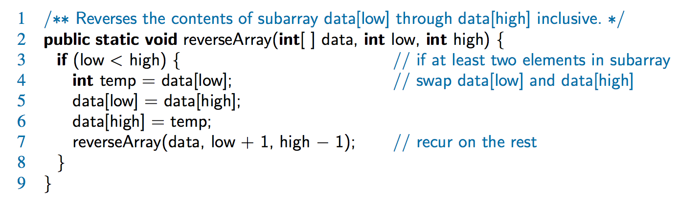
Defining Arguments for Recursion
In creating recursive methods, it is important to define the methods in ways that facilitate recursion.
This sometimes requires we define additional parameters that are passed to the method.
For example, we defined the array reversal method as reverseArray(A, i, j), not reverseArray(A)

Slide 15
Computing Powers
The power function, p(x,n)=x^{n}, can be defined recursively:
This leads to an power function that runs in O(n) time (for we make n recursive calls)
We can do better than this, however

Slide 16
Recursive Squaring
We can derive a more efficient linearly recursive algorithm by using repeated squaring:
For example,
  2⁴ = 2^{(4/2)2} = (2^{4/2})² = (2²)² = 4² = 16
  2⁵ = 2^{1+(4/2)2} = 2(2^{4/2})² = 2(2²)² = 2(4²) = 32
  2⁶ = 2^{(6/ 2)2} = (2^{6/2})² = (2³)² = 8² = 64
  2⁷ = 2^{1+(6/2)2} = 2(2^{6/2})² = 2(2³)² = 2(8²) = 128

Slide 17
Recursive Squaring Method
Algorithm Power(x, n):
Input: A number x and integer n = 0
Output: The value x^{n}
if n = 0 then
return 1
if n is odd then
y = Power(x, (n - 1)/ 2)
return x · y ·y
else
y = Power(x, n/ 2)
return y · y

Slide 18
Analysis
Algorithm Power(x, n):
Input: A number x and integer n = 0
Output: The value x^{n}
if n = 0 then
return 1
if n is odd then
y = Power(x, (n - 1)/ 2)
return x · y · y
else
y = Power(x, n/ 2)
return y · y
Each time we make a recursive call we halve the value of n; hence, we make log n recursive calls. That is, this method runs in O(log n) time.
It is important that we use a variable twice here rather than calling the method twice.

Slide 19
Tail recursion
Recursion is a useful tool for elegant, short algorithm definition
But costs memory to keep track of the state of each active recursive call.
Tail recursion: linear recursion is called as its very last operation.
Can convert a recursive algorithm into a non-recursive one, by iterating through the recursive calls rather than calling them explicitly
Algorithm IterativeReverseArray(A, i, j)
Input: An integer array A, non-negative indices i and j
Output: The reversal of elements in A starting at index i and ending at j
while i<j do
Swap A[i] and A[j]
i ← i+1
i ← j-1
return

Slide 20
Puzzle of Rabbits Population
Suppose a newly-born pair of rabbits, one male, one female, are put in a field.
Rabbits are able to mate at the age of one month
At the end of its second month a female can produce another pair of rabbits.
Suppose that
  our rabbits never die and
  the female always produces one new pair every month from the second month on.
How many pairs will there be in one year ?

Slide 21
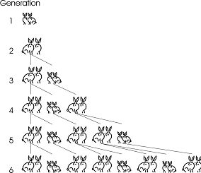

Slide 22
Binary recursion
An algorithm that makes two recursive calls
Example: Fibonacci numbers
1, 1, 2, 3, 5, 8, ….
Algorithm BinaryFib(k)
Input: Nonnegative integer k
Output: the k-th Fibonacci number F_{k}
if k≤1 then
return k
else
return BinaryFib(k-1)+BinaryFib(k-2)

Slide 23
Analysis
Let n_{k} be the number of recursive calls by BinaryFib(k)
  n₀ = 1
  n₁ = 1
  n₂ = n₁ + n₀ + 1 = 1 + 1 + 1 = 3
  n₃ = n₂ + n₁ + 1 = 3 + 1 + 1 = 5
  n₄ = n₃ + n₂ + 1 = 5 + 3 + 1 = 9
  n₅ = n₄ + n₃ + 1 = 9 + 5 + 1 = 15
  n₆ = n₅ + n₄ + 1 = 15 + 9 + 1 = 25
  n₇ = n₆ + n₅ + 1 = 25 + 15 + 1 = 41
  n₈ = n₇ + n₆ + 1 = 41 + 25 + 1 = 67.
Note that n_{k} at least doubles every other time
That is, n_{k} > 2^{k/2}. It is exponential!

Slide 24
A Better Fibonacci Algorithm
Use linear recursion instead
    Algorithm LinearFibonacci(k):
    Input: A nonnegative integer k
    Output: Pair of Fibonacci numbers (F_{k} , F_{k−1})
    if k = 1 then
    return (k, 0)
    else
    (i, j) = LinearFibonacci(k − 1)
    return (i +j, i)
LinearFibonacci makes k−1 recursive calls

Slide 25
Climb steps
You are climbing a stair case.
It takes n steps to reach the top.
Each time you can climb one or two steps.
How many distinct ways can you climb to the top?

Slide 26
Tower of Hanoi
The goal is to move all the disks to post 3.
The rule is that a bigger disk cannot be placed on top of a smaller disk.

Slide 27
Tower of Hanoi
It is easy if we only have 2 disks.
A total of 3 steps.

Slide 28
Tower of Hanoi
It is not difficult if we only have 3 disks.
Continue in next page

Slide 29
Tower of Hanoi
It is not difficult if we only have 3 disks.
A total of seven steps.

Slide 30

Tower of Hanoi
Can you write a program to solve this problem?
Think recursively!

Slide 31
Tower of Hanoi
Suppose you already have a program for 3 disks.
Can you use it to solve 4 disks?
In order to move the largest disk,
move the top 3 disks first,
and the program for 3 disks.
Then move the largest disk.
Then use the program to move
the 3 disks from pole 2 to pole 3.
Since the program requires 7 steps,
the total number of steps is 15.

Slide 32
Tower of Hanoi
This recursion is true for any n.
In order to move the largest disk,
move the top n-1 disks first,
and use the program for n-1 disks.
Then move the largest disk.
Then use the program again to move
the n-1 disks from pole 2 to pole 3.
Since the program requires r_{n-1} steps,
the total number of steps is 2r_{n-1} + 1.
r_{n} = 2r_{n-1} + 1

Slide 33
Follow up
If we have a constraint that a disk cannot move between pole 1 and pole 3, how many steps are needed in this case?
Can we use fewer steps if we have 4 poles?

Slide 34
Exercises
Use recursion to write a Java method for determining if a string s has more vowels than consonants.
Write a recursive Java method that takes a character string s and outputs its reverse. So for example, the reverse of “pots&pans” would be “snap&stop”.
Write a recursive Java method that will rearrange an array of int values so that all the even values appear before all the odd values.
Write a recursive Java method that determines if a string s is a palindrome, that is, it is equal to its reverse. For example, “racecar” is a palindrome, but “monmouth” is not.

Slide 35
Merge Sort
Given a sequence of n numbers,
how many steps are required to sort them into non-decreasing order?
One way to sort the number is called the “bubble sort”, in which every step we search for the smallest number, and move it to the front.
This algorithm could take up to roughly n²/2 steps.
For example, if we are given the reverse sequence n,n-1,n-2,…,1.
Every time it will search to the end to find the smallest number,
and the algorithm takes roughly n+(n-1)+(n-2)+…+1 = n(n+1)/2 steps.
Can we design a faster algorithm?
Think recursively!

Slide 36
Merge Sort
Suppose we have a program to sort n/2 numbers.
We can use it to sort n numbers in the following way.
3 8 4 7 2 1 6 5
Divide the sequence into two halves.
Use the program to sort the two halves independently.
3 4 7 8
1 2 5 6
With these two sorted sequences of n/2 numbers,
we can merge them into a sorted sequence of n numbers easily!

Slide 37
Merge Sort
Claim. Suppose we have two sorted sequence of k numbers.
We can merge them into a sorted sequence
of 2k numbers in 2k steps.
Proof by example:
3 5 7 8 9 10
1 2 4 6 11 12
To decide the smallest number in the two sequences,
we just need to look at the “heads” of the two sequences.
So, in one step, we can extend the sorted sequence by one number.
So the total number of steps for 2k numbers is 2k.

Slide 38
Merge Sort
3 5 7 8 9 10
1 2 4 6 11 12
1
3 5 7 8 9 10
1 2 4 6 11 12
1 2
3 5 7 8 9 10
1 2 4 6 11 12
1 2 3
3 5 7 8 9 10
1 2 4 6 11 12
1 2 3 4
3 5 7 8 9 10
1 2 4 6 11 12
1 2 3 4 5
3 5 7 8 9 10
1 2 4 6 11 12
1 2 3 4 5 6
3 5 7 8 9 10
1 2 4 6 11 12
1 2 3 4 5 6 7
3 5 7 8 9 10
1 2 4 6 11 12
1 2 3 4 5 6 7 8
3 5 7 8 9 10
1 2 4 6 11 12
1 2 3 4 5 6 7 8 9
3 5 7 8 9 10
1 2 4 6 11 12
1 2 3 4 5 6 7 8 9 10
3 5 7 8 9 10
1 2 4 6 11 12
1 2 3 4 5 6 7 8 9 10 11
3 5 7 8 9 10
1 2 4 6 11 12
1 2 3 4 5 6 7 8 9 10 11 12

Slide 39
Merge Sort
Claim. Suppose we have two sorted sequence of k numbers.
We can merge them into a sorted sequence
of 2k numbers in 2k steps.
Suppose we can sort k numbers in T_{k} steps.
Then we can sort 2k numbers in 2T_{k} + 2k steps.
Therefore, T_{2k} = 2T_{k} + 2k.
If we solve this recurrence (which we will do later),
then we see that T_{2n} ≈ n log₂ n.
This is significantly faster than bubble sort!

Slide 40
Remark
This is one example of a “divide and conquer” algorithm.
This idea is very powerful.
It can be used to design faster algorithms for some basic problems
such as integer multiplications, matrix multiplications, etc.

